Slide 1


trainity
IMDB DATA
ANALYSIS
SALMAN BAREESH

Slide 2


The project aims to analyze an IMDB Movies dataset to understand the factors influencing a movie's success, defined by high IMDB ratings.
The investigation involves exploring various aspects such as movie genres, duration, language, directors, and budget to provide actionable insights for stakeholders in the film industry.

Slide 3





Five 'Whys' approach
Cleaning data (Dropping columns, removing null values, etc.)
Perform relevant descriptive statistic calculations to gain a general understanding o fdataset.
Perform Analysis: Joined the data bits and structured the tables to derive business insights, used pivot tables, fetched the required results and hence, created useful insights for the company to take calculated and planned decisions.

Slide 4



MS Excel used to do statistical analysis
Canva used to do Presentation

Slide 5

Movie Genre Analysis: Determined common genres and analyzed their impact on IMDB scores.
Movie Duration Analysis: Analyzed movie duration distribution and its impact on IMDB scores.
Language Analysis: Determined common languages and analyzed their impact on IMDB scores.
Director Analysis: Identified top directors based on average IMDB score and analyze their contribution.
Budget Analysis: Explored the relationship between movie budgets and financial success.

Slide 6
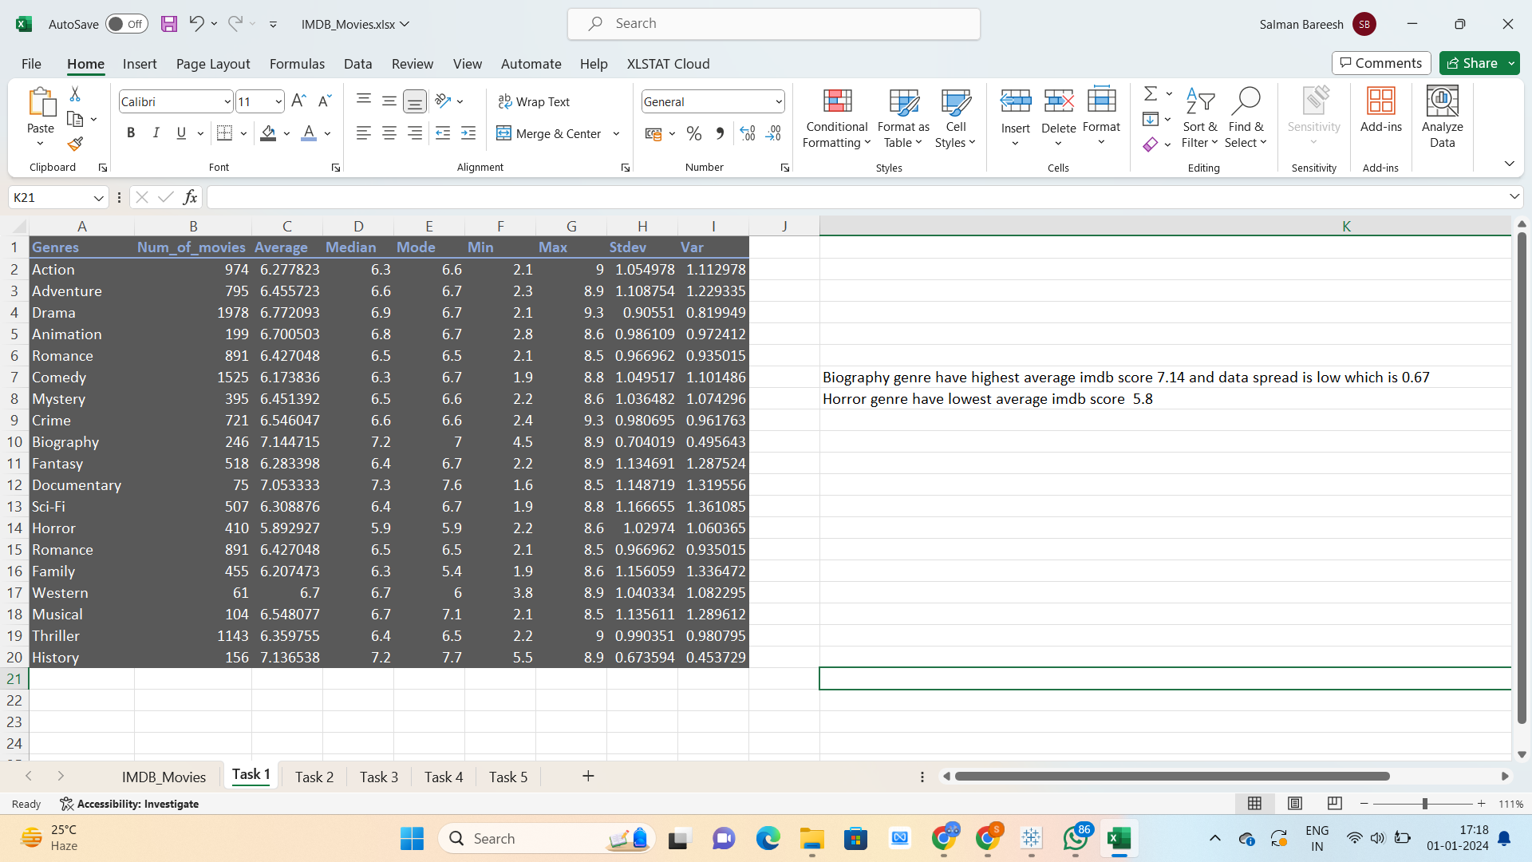
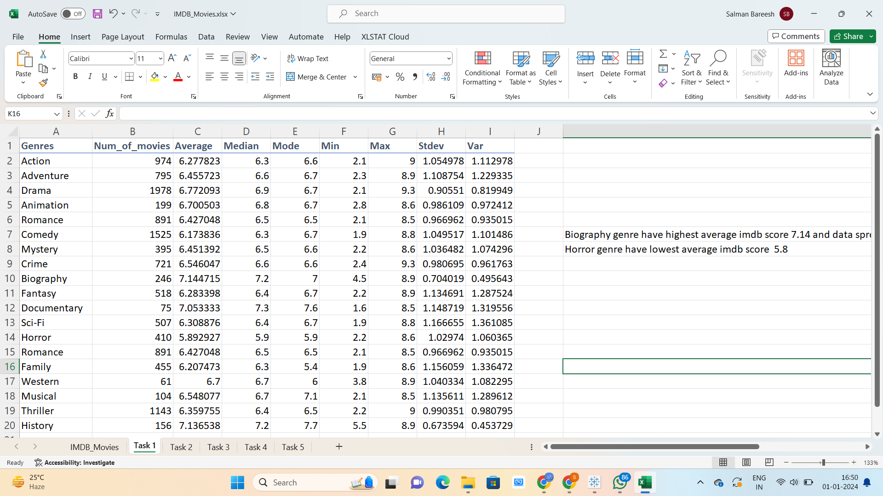
A. MOVIE GENRE
ANALYSIS
Biography genre have highest average imdb score 7.14 and data spread is low which is 0.67
Horror genre have lowest average imdb score 5.8

Slide 7
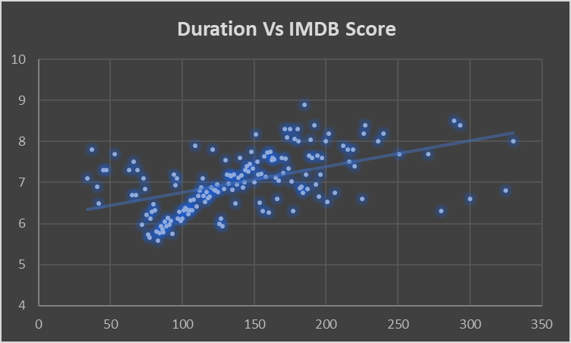
B. MOVIE DURATION
ANALYSIS
As trendline moves slantingly upward
Duration and IMDB score have low positive correlation

Slide 8
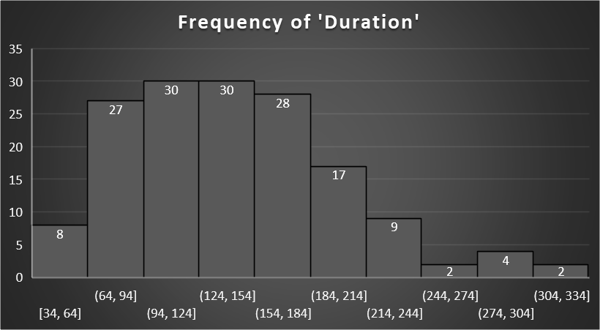
B. MOVIE DURATION
ANALYSIS
Most movies have duration of 94-154 minutes
The duration of 65 mins have highest average IMDB score of 8.9

Slide 9
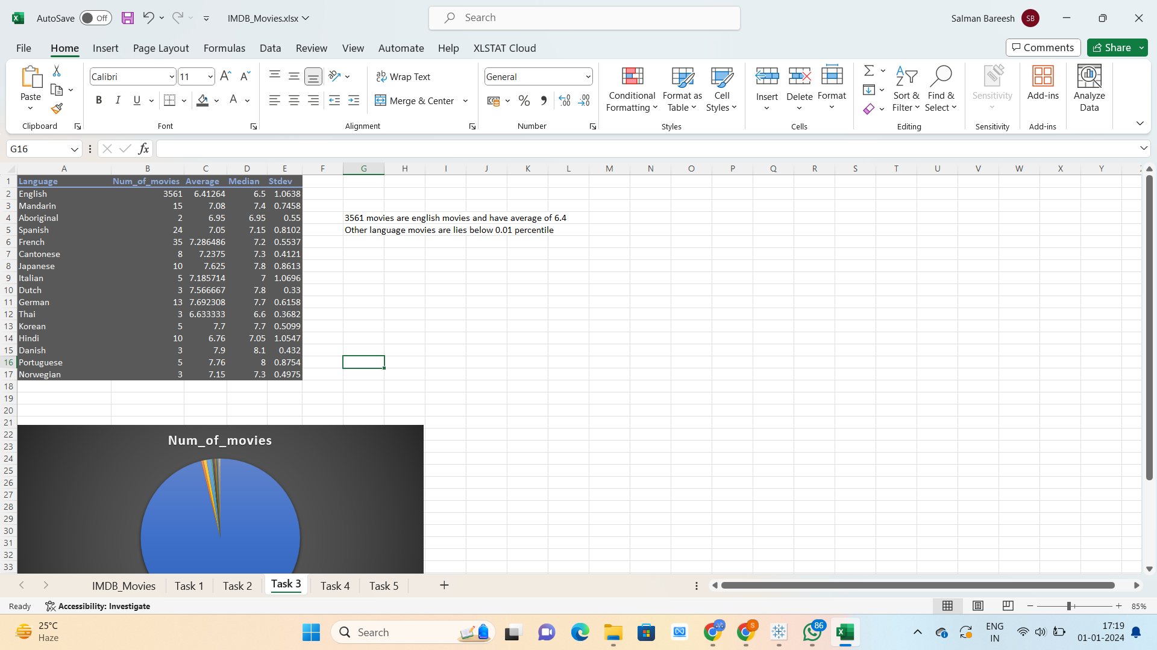
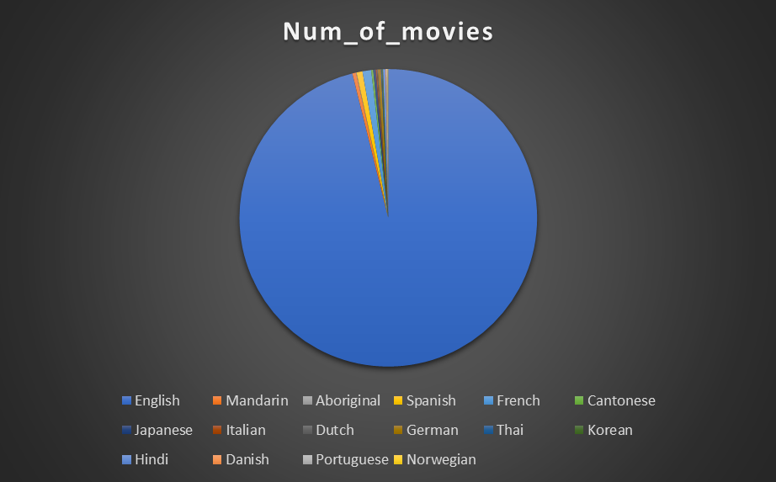
C. LANGUAGE
ANALYSIS
3561 movies are english movies and have average of 6.4
Other language movies are lies below 0.01 percentile

Slide 10
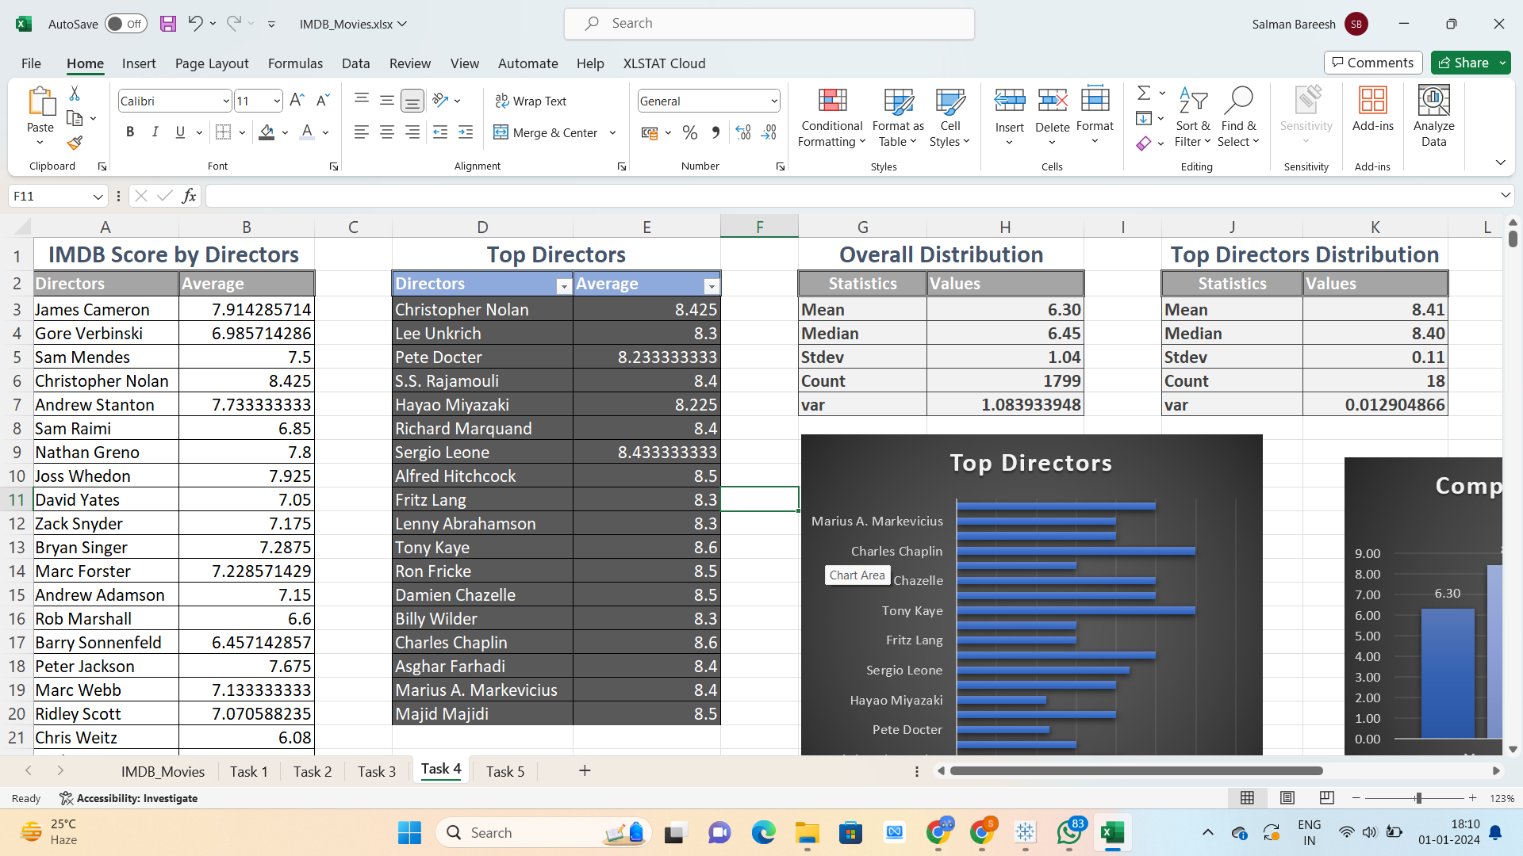
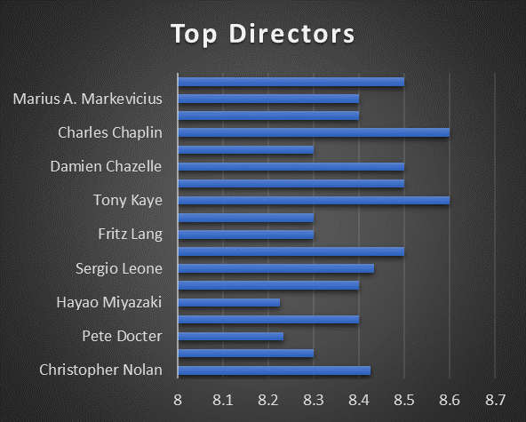
D. DIRECTOR
ANALYSIS
Tony Kayle has the highest average imdb score among top directors
Paul thomas has the lowest average imdb score top directors

Slide 11
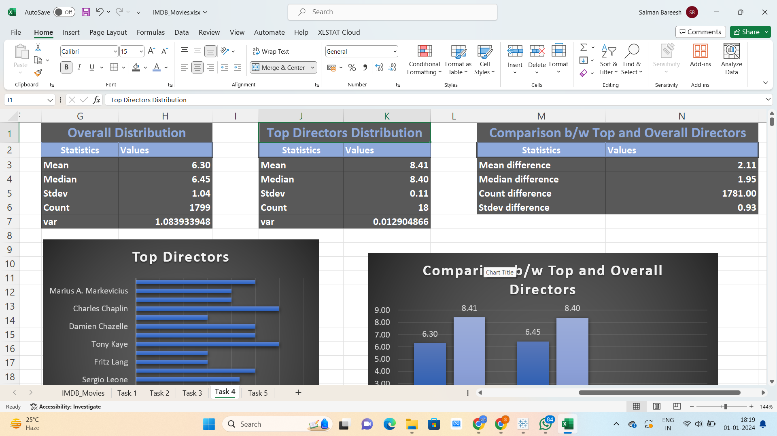
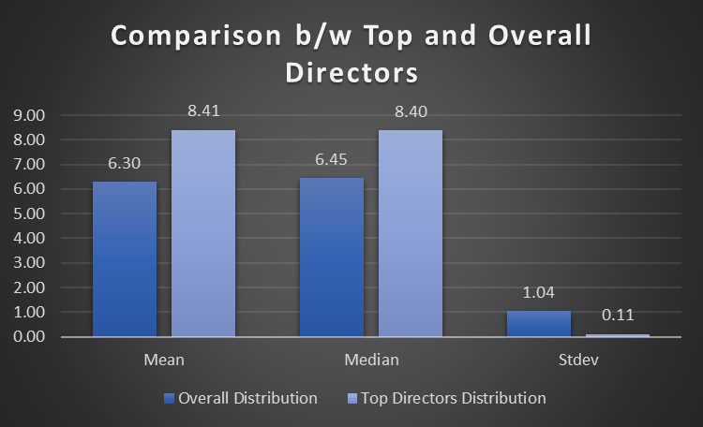
D. DIRECTOR
ANALYSIS
There is significance difference between overall and top directors distribution

Slide 12
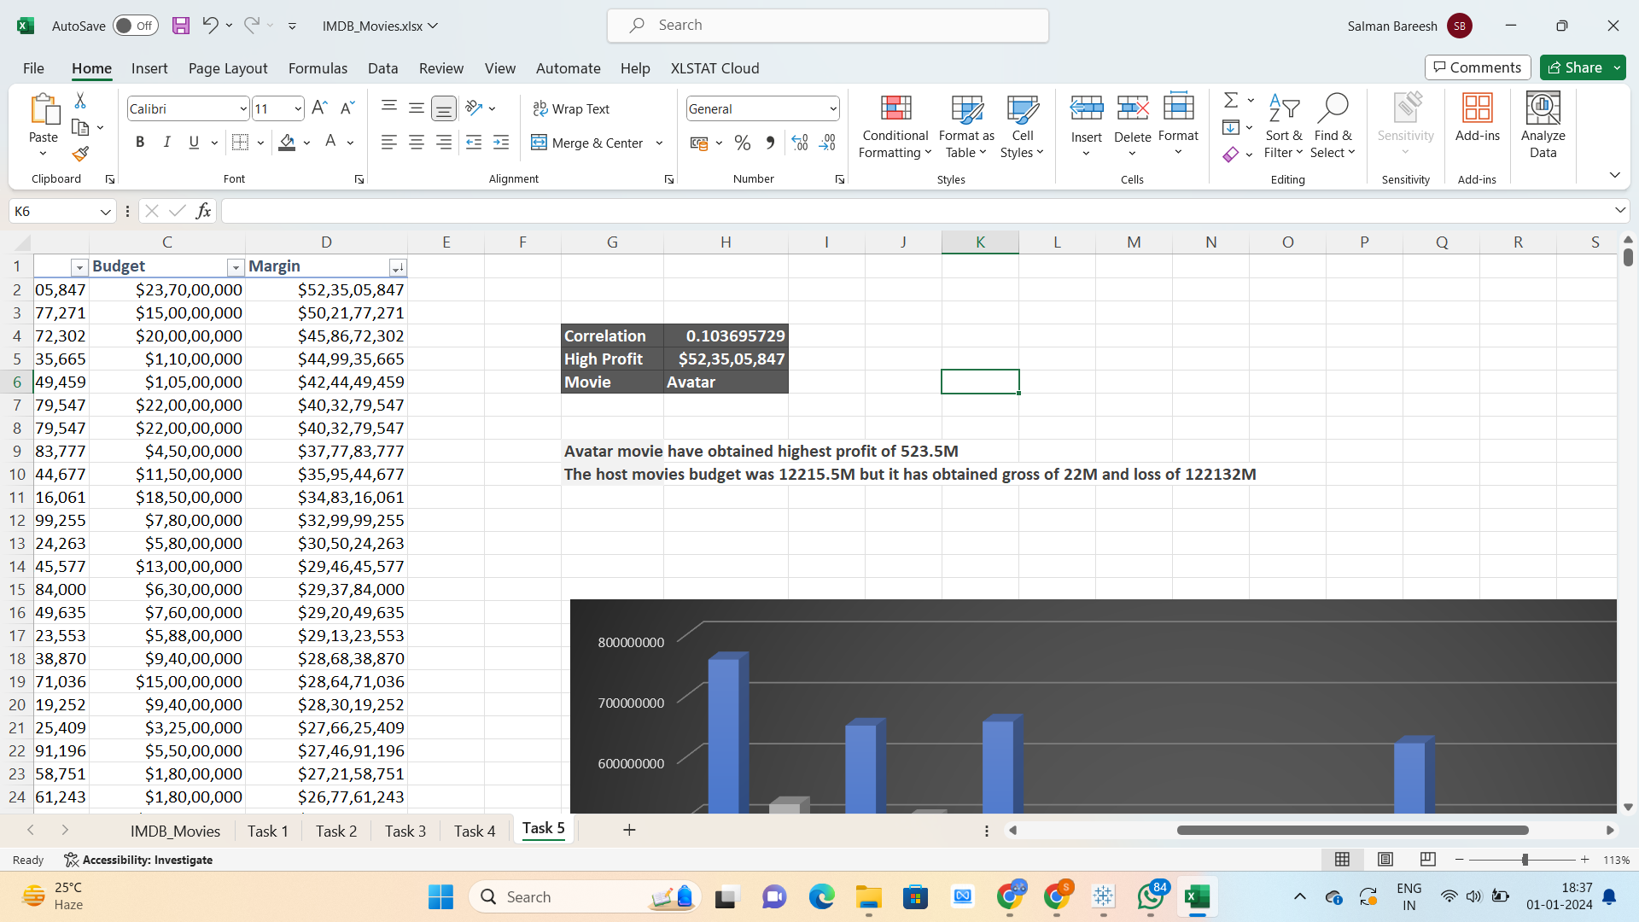
E. BUDGET
ANALYSIS
Avatar movie have obtained highest profit of 523.5M
The host movie budget was 12215.5M but it has obtained gross of 22M and loss of 122132M

Slide 13
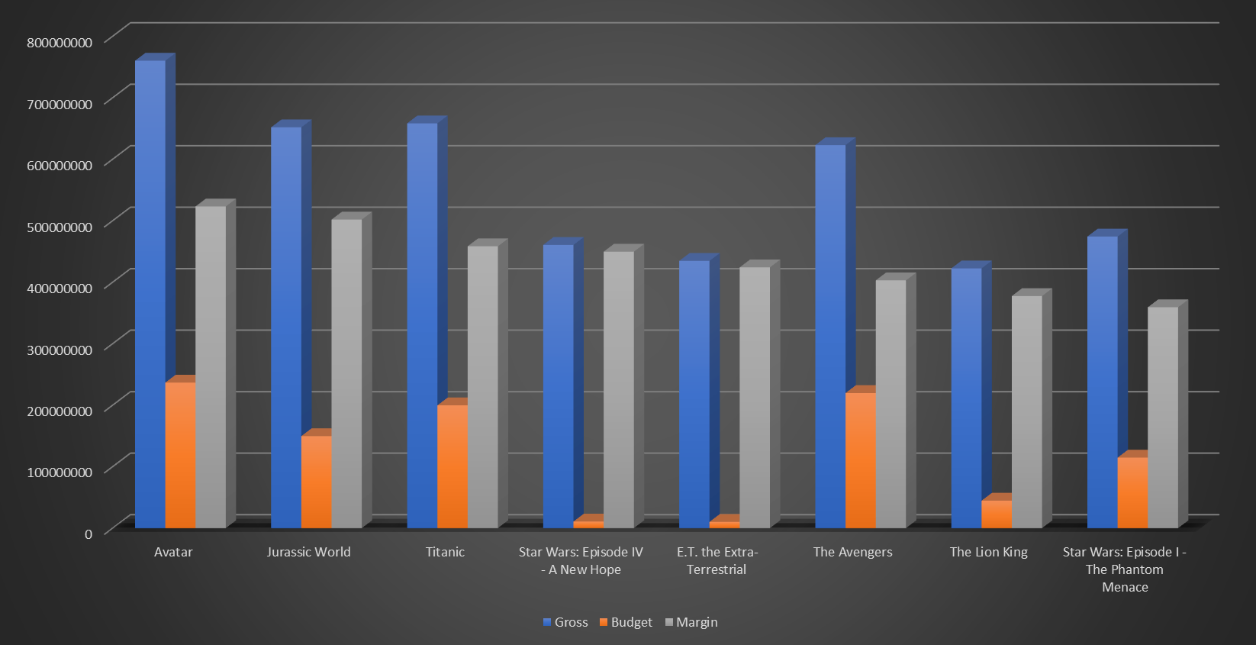
E. BUDGET
ANALYSIS

Slide 14

Understanding of cleaning and modifying data is very important. Removing unnecessary data i.e. columns, blank spaces or cells, etc. makes the data much more readable.
Outliers identification and removal changes the results of data analysis. Presenting data with charts and graphs makes it look way more interesting and clear.
Click here for excel file with task solutions

Slide 15
trainity
THANK YOU

